Slide 1
Python Fundamentals - Day 2
Python Functions - Part One

Slide 2
Python Functions: Intro
In Python, functions are blocks of reusable code that perform a specific task.
They allow you to break down your code into smaller, more manageable pieces, making it easier to read, understand, and maintain.
Functions can take input values, called arguments or parameters, and can return a result.

Slide 3
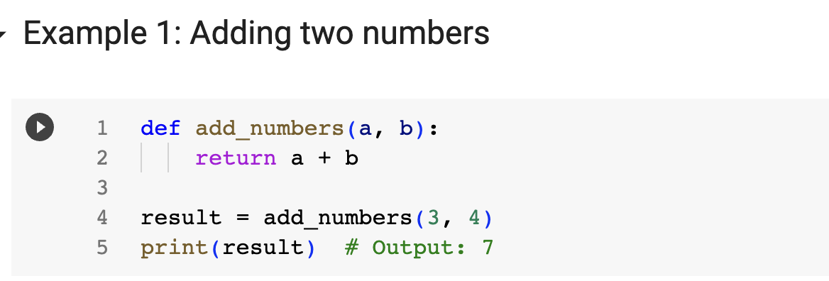

Slide 4
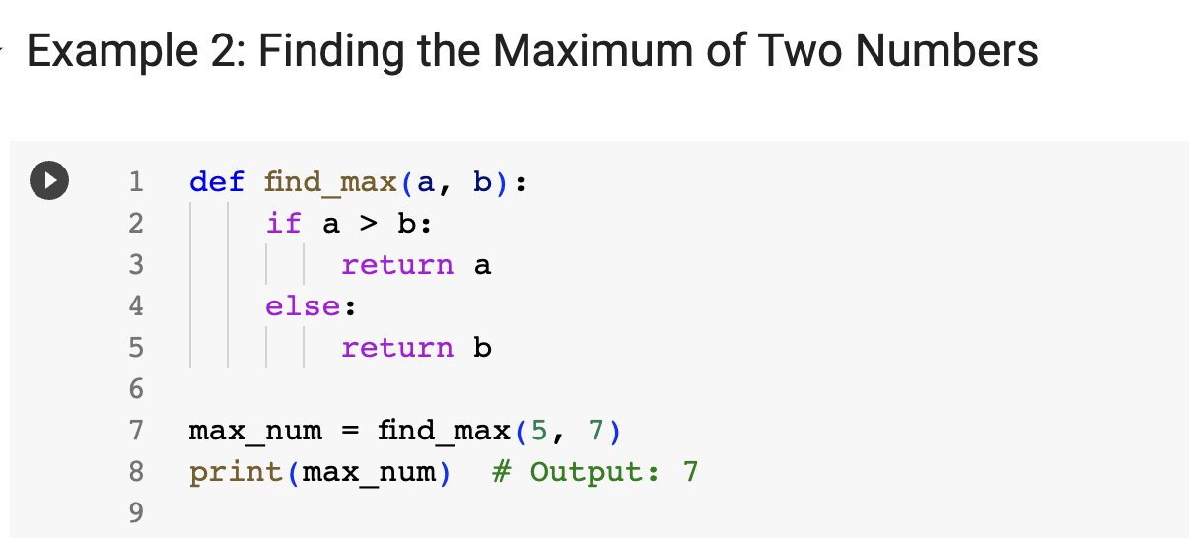

Slide 5
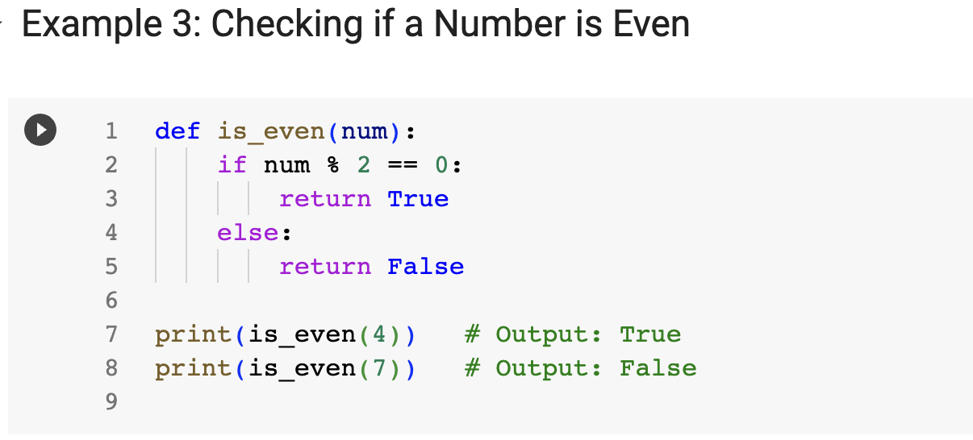

Slide 6
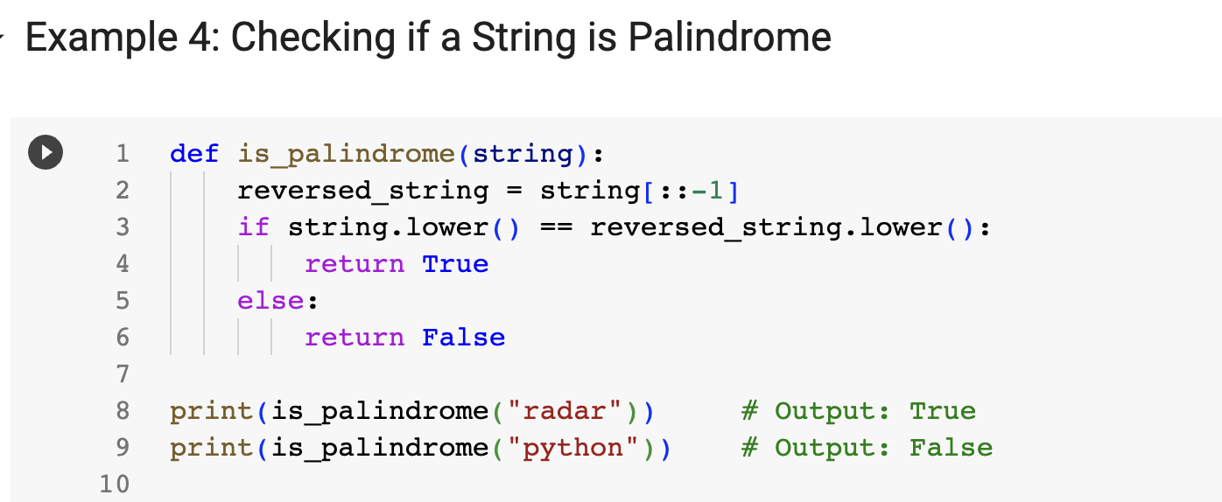

Slide 7
Exercise 1: Python Slicing
Link: https://docs.google.com/document/d/1Uqlfc8ccXJlIjWOZBwkLBcwDPXo3gdXH_0MA8JULvnA/edit?usp=sharing

Slide 8
Exercise 2: Scheduling Jobs
Link: https://docs.google.com/document/d/1mQgq6ux9AQv9DtUAB8i8r1Nu2HhqoJubYxweY_zRTNY/edit?usp=sharing

Slide 9
Python Functions: Positional Arguments
These are arguments that are passed to a function in the order they are defined.
The values are matched with the corresponding parameters based on their positions.

Slide 10
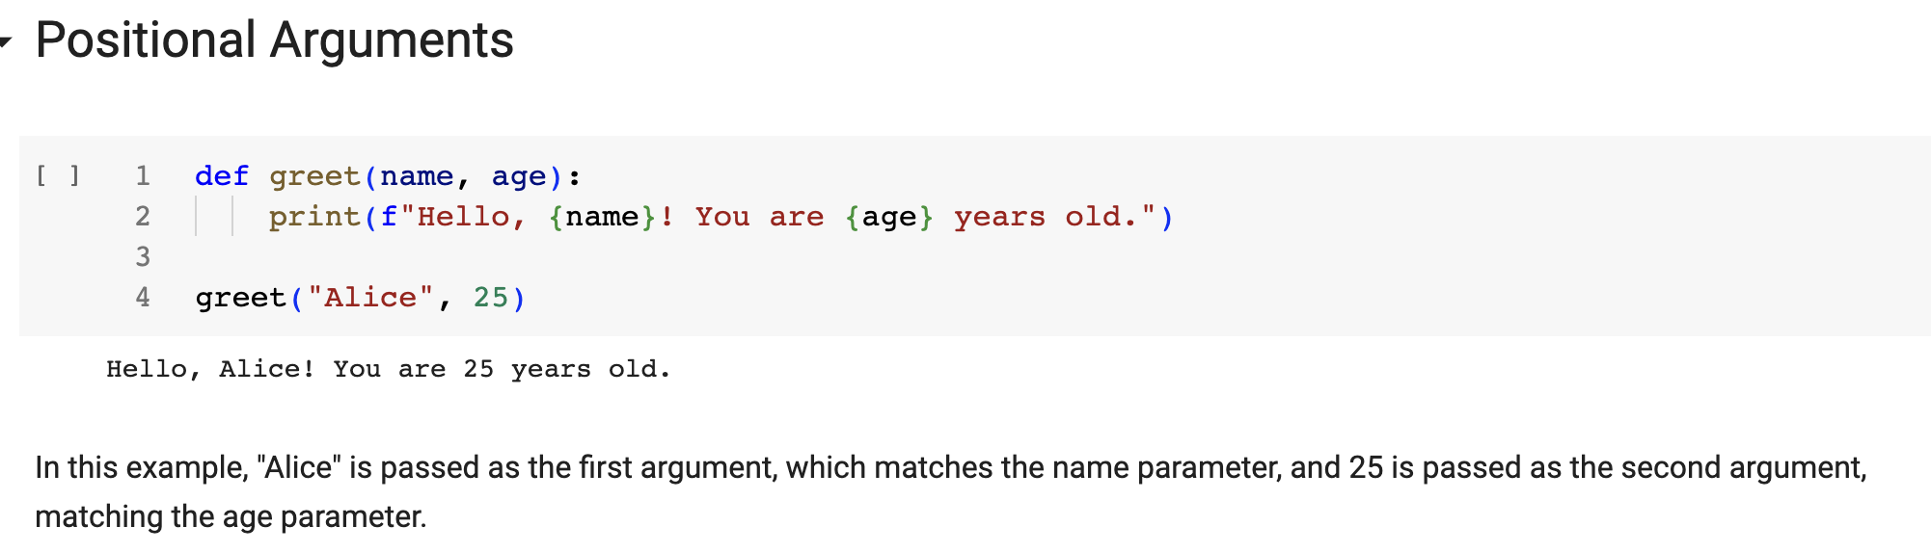

Slide 11
Python Functions: Keyword Arguments
These arguments are specified by the parameter name followed by an equals sign (=) and the value.
Keyword arguments allow you to specify the argument's value explicitly, regardless of the order.

Slide 12
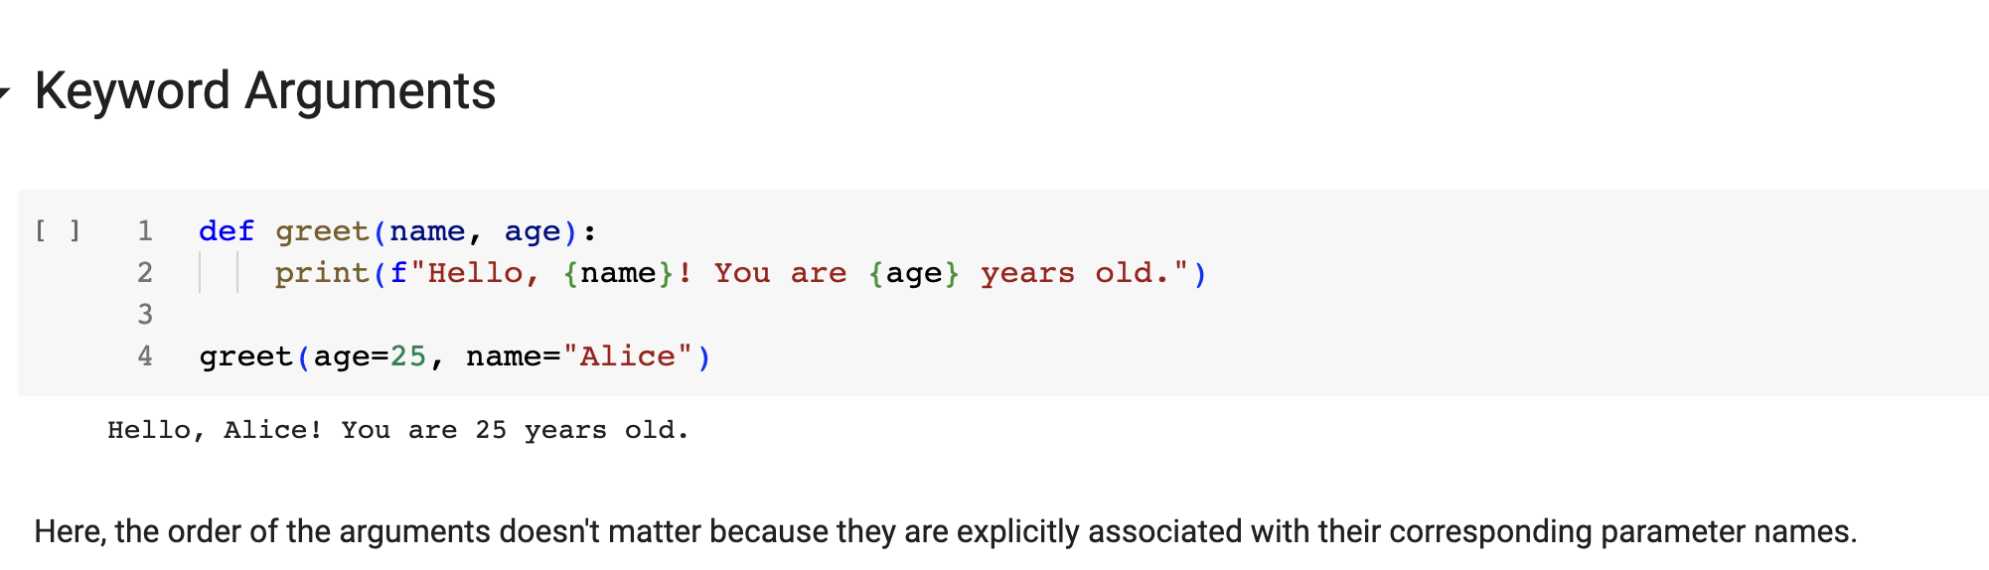

Slide 13
Python Functions: Default Arguments
These are parameters that have a default value specified in the function definition.
If an argument is not provided for a default parameter, the default value is used.

Slide 14
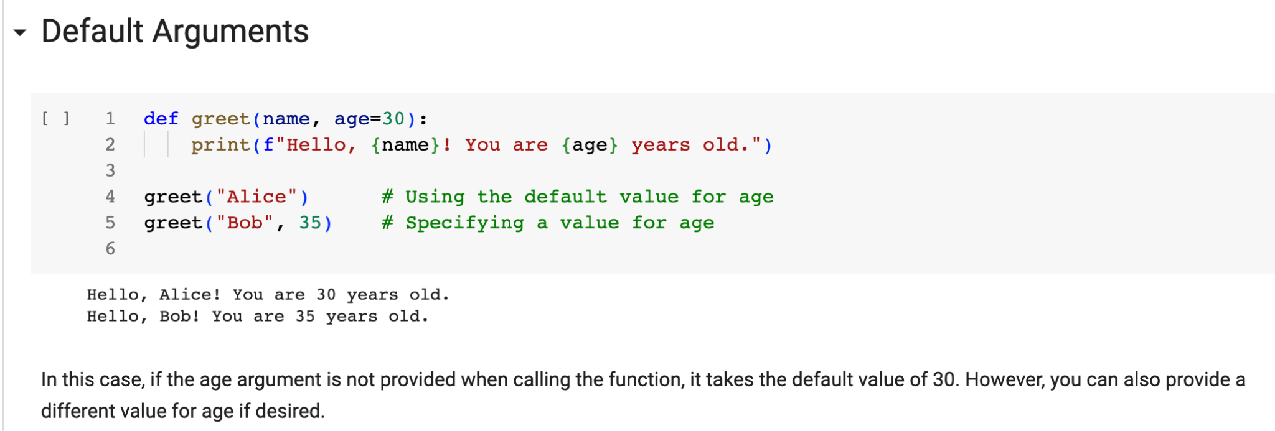

Slide 15
Python Functions: Variable-Length Arguments
These are used when the number of arguments that a function can accept is not fixed. There are two types of variable-length arguments in Python:
*args: It allows a function to accept any number of positional arguments. The arguments are collected into a tuple inside the function.
**kwargs: It allows a function to accept any number of keyword arguments. The arguments are collected into a dictionary inside the function.

Slide 16
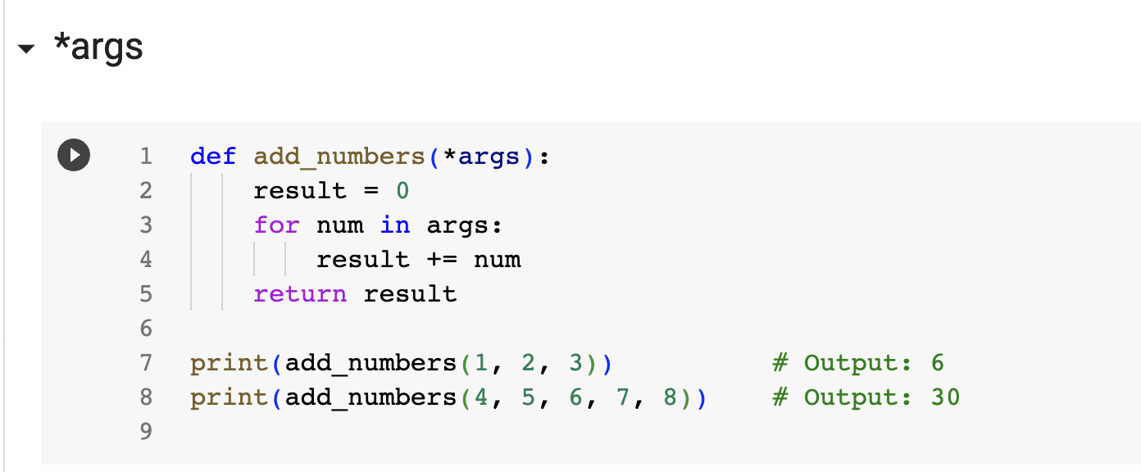

Slide 17
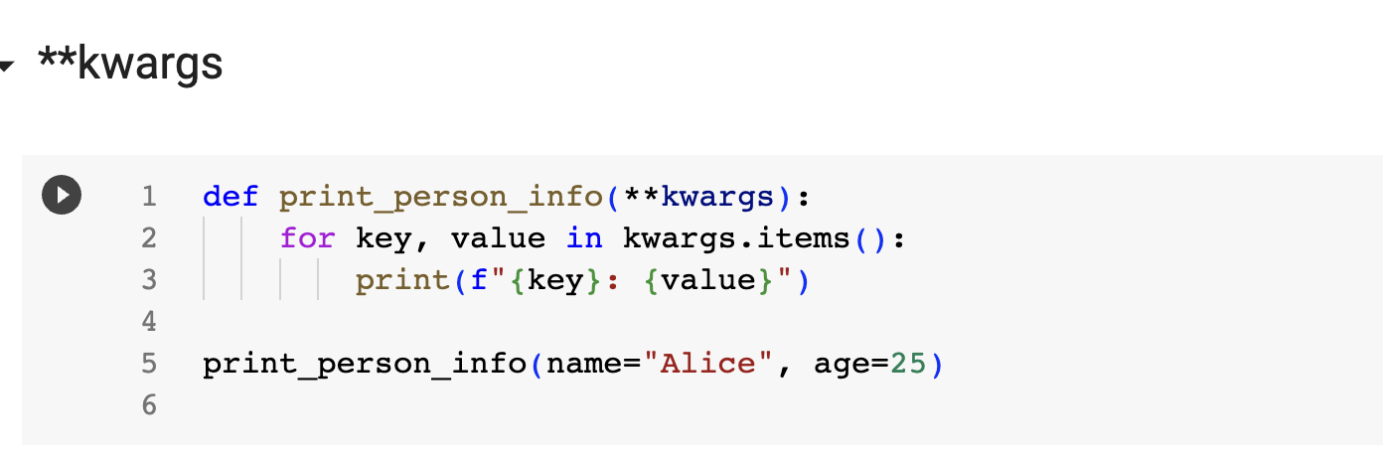

Slide 18
Code Demo: Online Store Inventory
You are building an online store inventory system. Write a Python function called update_inventory that takes in the current inventory as a list of dictionaries and updates it with new items.
The function should accept any number of arguments (items) as positional arguments and any additional item details as keyword arguments (quantity, price, etc.). The function should return the updated inventory.

Slide 19
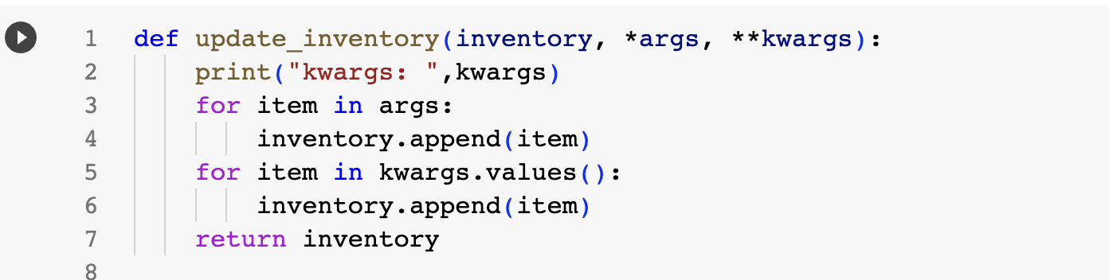

Slide 20
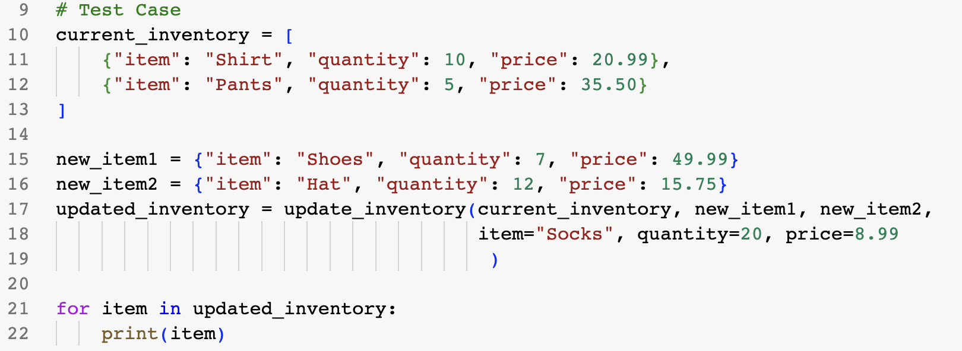

Slide 21
Key Takeaway
The key takeaway regarding the order of `*args` and `**kwargs` in Python functions is as follows:
1. The convention is to place `*args` before `**kwargs` when defining a function that accepts both variable-length positional arguments and keyword arguments.
2. `*args` collects any number of positional arguments and stores them as a tuple.
3. `**kwargs` collects any number of keyword arguments and stores them as a dictionary.
4. By following the convention, you ensure that positional arguments are assigned to `args` and keyword arguments are assigned to `kwargs`.
5. Adhering to the convention improves code readability and maintainability, making it easier for others to understand your code.

Slide 22
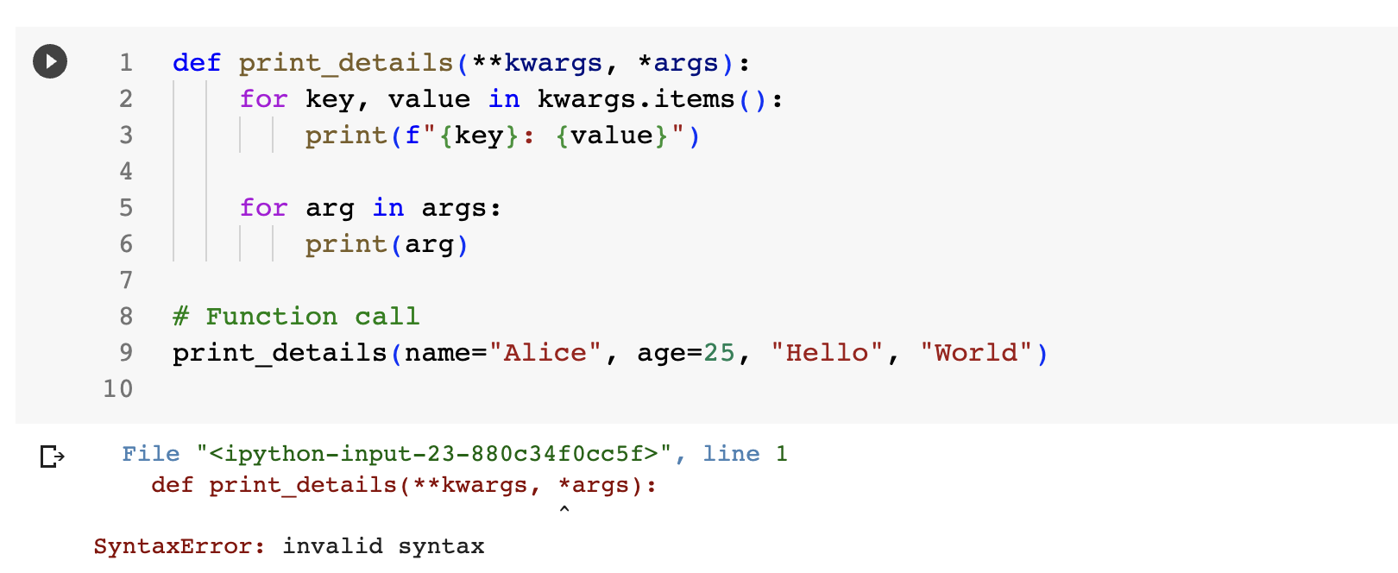

Slide 23
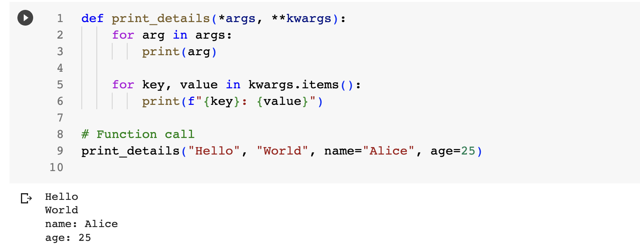

Slide 24
Exercise 3: Car Parking
Link: https://docs.google.com/document/d/1RxzI0tybSGk97CJEkq4oDXiH6vYwKAoOChVnR04NYMk/edit?usp=sharing

